Slide 1
Migrating from rebar2.x to rebar3.x

Slide 2
Content
3 =/= 2 + 1
Commands and configuration
Installation
Cleaning up existing projects
First steps for K2
References

Slide 3
3 =/= 2 + 1
rebar3 is not the next iteration of rebar2 !!!
different workflow
different logic
different behaviour
treat it like migrating to a different build tool !!!

Slide 4
3 =/= 2 + 1 – Basic usage
rebar3 only handles OTP-structured projects
the new command creates a project from a template
1. argument: lib, app, release or plugin
2. argument: name
dependencies are listed in the rebar.config file under the deps key
{deps, [{cowboy, "1.0.1"},
{cowboy, {git, "git://github.com/ninenines/cowboy.git", {tag, "1.0.1"}}}
]}.
{cowboy, ".*", {git, "git://github.com/ninenines/cowboy.git", {tag, "1.0.1"}}}
compile fetches dependencies and compiles all applications
no rebar get-dependencies command
no abbreviated commands

Slide 5
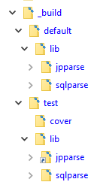
3 =/= 2 + 1 – Basic usage
output is found in the _build directory at the root of the project
installing dependencies
building releases
any other output written to disk
tests by default are expected to be found under the test/ directory, aside from eunit found within individual modules

Slide 6
Commands and configuration
clean - removes compiled beam files from apps
rebar3 clean - only cleans the default profile
rebar3 as test clean - only cleans the test profile
-–all – can be added to clear dependencies' beams
compile - ensures / fetches all dependencies and compiles the needed dependencies and the project's apps .app.src and .erl files
{erl_opts, … / {erl_first_files, … / {xrl_opts, … / {yrl_opts, …
cover - coverage analysis on modules called by CT or Eunit
{cover_enabled, … / {cover_excl_mods, …
ct - runs common tests located under the test/ directory
{ct_cover, … / {ct_use_short_names, … / {ct_verbose, …
deps - lists source and package dependencies
dialyzer - builds the PLT and carries out success typing analysis
{dialyzer_plt_location, … / {dialyzer_warnings, …

Slide 7
Commands and configuration
edocs - generates documentation using doc
eunit - runs eunit tests on project apps
{eunit_opts, …
new - creates new projects from templates
tree - prints a tree of dependencies
upgrade - upgrades dependencies (and lock file)
version - prints version for rebar3 and current Erlang
xref - runs cross reference analysis
{xref_checks, …

Slide 8
Installation
create a new directory e.g. c:\Software\rebar3
download the latest rebar3 from https://www.rebar3.org/
create a script called rebar3.cmd in the rebar3 directory:
@echo off
setlocal
set rebarscript=%~f0
escript.exe "%rebarscript:.cmd=%" %*
add the rebar3 directory to your PATH variable

Slide 9
Cleaning up existing projects
remove the following directories:
.rebar
_rel
ebin
deps
.gitignore: remove these entries and add new _build
rebar.config: remove the entries sub_dirs and lib_dirs
review the .app.src files
applications you depend on are listed in the applications tuple
no circular dependencies
the following fields are mentioned (releases):
applications, description, env, registered, vsn

Slide 10
Cleaning up existing projects
handles releases and OTP applications only
dependencies should only be OTP applications
one of the following directory structures:
src/*.{erl,app.src}
or
apps/app1/src/*.{erl,app.src}
apps/app2/src/*.{erl,app.src}
apps/app3/src/*.{erl,app.src}
or
lib/app1/src/*.{erl,app.src}
lib/app2/src/*.{erl,app.src}
lib/app3/src/*.{erl,app.src}
no get-dependencies command
no longer re-compiles dependencies once it has done so before
no longer checks or enforces dependencies – instead uses a ‘nearest to the root’ dependency algorithm
mostly applicable in rebar.config: {deps_error_on_conflict, true}

Slide 11
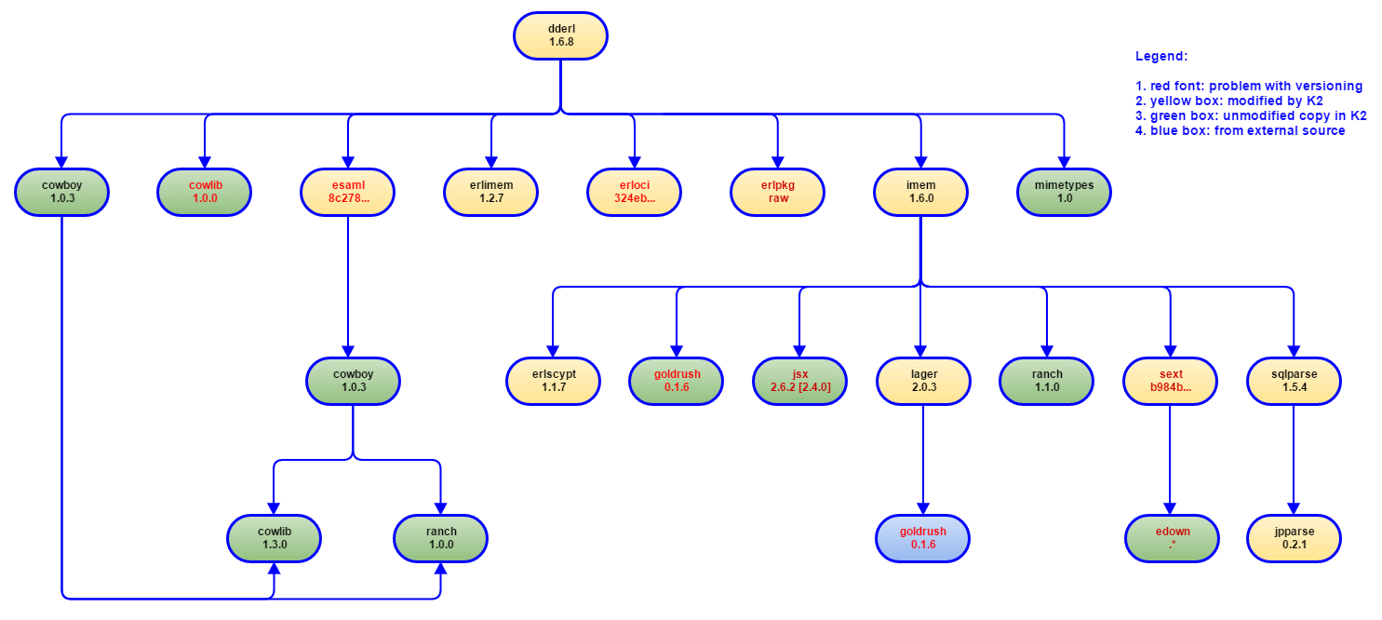
First steps for K2

Slide 12
First steps for K2
Project sqlparse - .gitignore
_build erl_crash.dump rebar.lock
rebar3.crashdump src/*.dot src/sql_lex.erl src/sqlparse.erl test/*.beam

Slide 13
First steps for K2
Project sqlparse – rebar.config
{cover_enabled, true}. {cover_excl_mods, [sql_lex, sqlparse]}. {ct_cover, true}. {ct_verbose, true}. {deps, [{jpparse, {git, "https://github.com/K2InformaticsGmbH/jpparse.git", {tag, "0.2.1"}}}]}.
{deps_error_on_conflict, true}. {dialyzer_plt_location, local}. {dialyzer_warnings, [error_handling, overspecs, race_conditions, specdiffs, underspecs, unknown, unmatched_returns ]}. …

Slide 14
First steps for K2
Project sqlparse – rebar.config
… {eunit_opts, [ {skip_deps, true}, verbose ]}. {xrl_opts, [dfa_graph, verbose]}. {yrl_opts, [verbose]}.

Slide 15
First steps for K2
Project sqlparse – sqlparse.app.src
{application, sqlparse, [ {applications, [ kernel, stdlib, jpparse ]}, {description, "A LALR SQL parser and compiler"}, {modules, [sqlparse]}, {vsn, "1.5.4"} ]}.

Slide 16
First steps for K2
Project sqlparse – sqlparse.app.src
{mod, {CallbackMod, Args}}
Defines a callback module for the application, using the application behaviour. This tells OTP that when starting your application, it should call CallbackMod:start(normal, Args). This function's return value will be used when OTP will call CallbackMod:stop(StartReturn) when stopping your application. People will tend to name CallbackModafter their application.
{modules, [ModuleList]}
Contains a list of all the modules that your application introduces to the system. A module always belongs to at most one application and can not be present in two applications' app files at once. This list lets the system and tools look at dependencies of your application, making sure everything is where it needs to be and that you have no conflicts with other applications already loaded in the system. If you're using a standard OTP structure and are using a build tool like rebar3, this is handled for you.

Slide 17
First steps for K2
Project sqlparse – .travis.yml
install: - wget https://s3.amazonaws.com/rebar3/rebar3 && chmod +x rebar3 language: erlang otp_release: - 18.3 - 18.2.1 - 18.2 - 18.1 - 18.0 script: - ./rebar3 compile - ./rebar3 eunit

Slide 18
References
Website
https://www.rebar3.org/
Github
https://github.com/erlang/rebar3

